Slide 1
ANZ Virtual Internship Exploratory Analysis
Prepared by Satinderjit Singh
Computer Engineer
Thapar Institute of Engineering and Technology

Slide 2
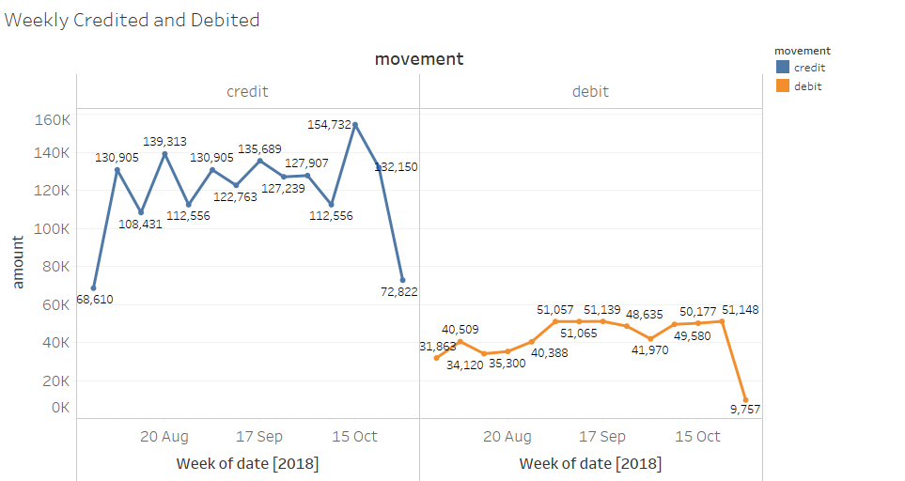

Slide 3
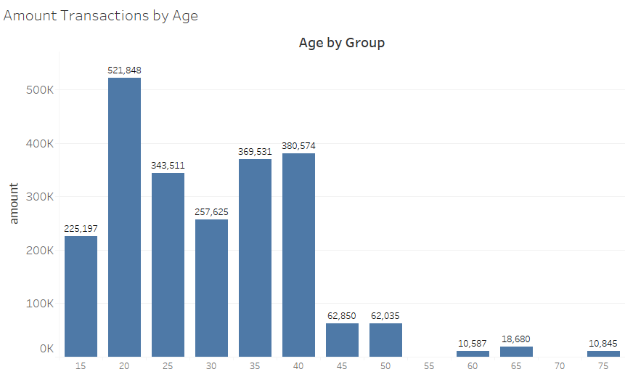

Slide 4
